Slide 1
MBARARA UNIVERSITY OF SCIENCE AND TECHNOLOGY
MUSASIZI NOREEN
GROUP B
2025/BCS/201/PS

Slide 2
TABLE OF CONTENT
Executive summary
Database project
Area of interest
Possible database systems
Reason for the area of interest
Business case
Application domain
Analysis of benefits
Analysis of costs
User issues
Risk assessment

Slide 3
CONTINUATION OF TABLE OF CONTENT
List of entities
List of entities and attributes
Entity relationships
Add multiplication to 4.3
User interface
Physical design
Database schema
Description of queries and reports
Implementation

Slide 4
Executive Summary
The Bakery management system is a relatiomal database solution designed to digitise and integrate core business operations,with a primary emphasis on the supplies mnagement module.
The system manages supplier information, supply orders, deliveries, and stock levels of bakery materials such as flour, sugar, and yeast.
By utilising normlised MySQL architecture,the system ensures data integrity while providing real time insights in to stock levels,staff performances and productioncosts. It was developed to improve accuracy in record keeping, reduce stock shortages, and support efficient procurement decisions.

Slide 5
DATABASE PROJECT: Bakery Database Management System
AREA OF INTEREST: Supplies Management system
Possible Database Systems
Supplies
Inventory
Customer
Orders
Employee

Slide 6
Reasons for choosing supplies management as the area of interest:
Supplies management ensures that essential bakery materials such as flour, sugar, yeast, and butter are available when needed.
It helps prevent stock shortages and delays that can interrupt daily production.
It improves record keeping for suppliers, deliveries, and purchase orders.
It supports better planning and cost control by monitoring inventory levels and replenishment needs.

Slide 7
Application Domain
Analysis benefits
Tangible benefits
Reduced stock shortages and wastage of bakery materials.
Faster retrieval of supply records, purchase orders, and delivery information.
Better control of inventory levels and procurement costs.

Slide 8
Intangible benefits
Better decision-making through reliable and organized information.
Improved efficiency in daily bakery operations.
Increased accountability among staff handling supplies.

Slide 9
Analysis of costs
Tangible costs
Purchase of computers and related equipment for running the database system.
Cost of installing and maintaining the database software.
Staff training expenses for effective use of the system.

Slide 10
Intangible costs
Time required for staff to adapt to the new system.
Temporary reduction in productivity during the transition from manual records.
Resistance to change from users who are accustomed to existing methods.

Slide 11
User issues
Staff require basic computer skills to use the system effectively.
Training is needed so users can correctly record supplies, deliveries, and stock updates.
Some staff may take time to adapt from manual record keeping to computerized records.
User acceptance and consistent use of the system are necessary for accurate and reliable information.

Slide 12
Risk assessment
Risk assessment is the process of identifying possible problems that may affect the operation of the system and evaluating how those problems can impact its performance, reliability, and effectiveness.

Slide 13
For the Bakery Database System:
Technical failures such as computer breakdowns or software errors may affect access to supply records.
Data loss may occur if the database is not regularly backed up.
Unauthorized access can compromise the security of supplier and inventory information.
Poor user adaption or incorrect data entry may reduce the reliability of the system

Slide 14
To conduct a risk assessment for your Bakery Database System, use a simple process:
Identify risks. list possible problems that could affect the system, such as data loss, power failure, hardware failure, or incorrect data entry.
Assess likelihood. Estimate how likely each risk is to happen (low, medium, or high).
Assess impact. Determine how much the risk would affect bakery operations if it occurs.
Plan controls. Decide how to reduce or manage each risk, such as regular backups, passwords, staff training, and maintenance.

Slide 15
Limitations
Data loss is unavoidable
Semi skilled labour
Technical Complexity

Slide 16
LOGICL DESIGN
a.list of entities
supplies
inventory
orders
employee

Slide 17
LISTS OF ENTITIES AND ATTRIBUTES
Supplies [ Supplier ID (primary key ) , Supplier name , Contact Person Name , Phone Number, Email Address , Physical Address , Payment Terms ].
Customers[ Customer ID (Primary key ), Full name, Email Address , Dietary Preferences ,].
Orders[ Order ID (Primary Key ), Order date , Customer ID ( Foreign key to link the buyer ) , Employee ID ( Foreign key to track who processed the sale ), Payment Status( such as Paid, Pending, Refunded), Order type ( such as Take away , Custom cake Delivery) ].
Inventory [ Inventory ID(Primary key ), Item Name ( such as butter), Current quantity , Unit of measure , Expiry Date , Storage location ].
Employees[ Employee ID (Primary key), First name and last name , Role ( such as Pastry chef , Cashier, Head Baker, Contact number and email Address , Hire Date , Salary.]
_

Slide 18
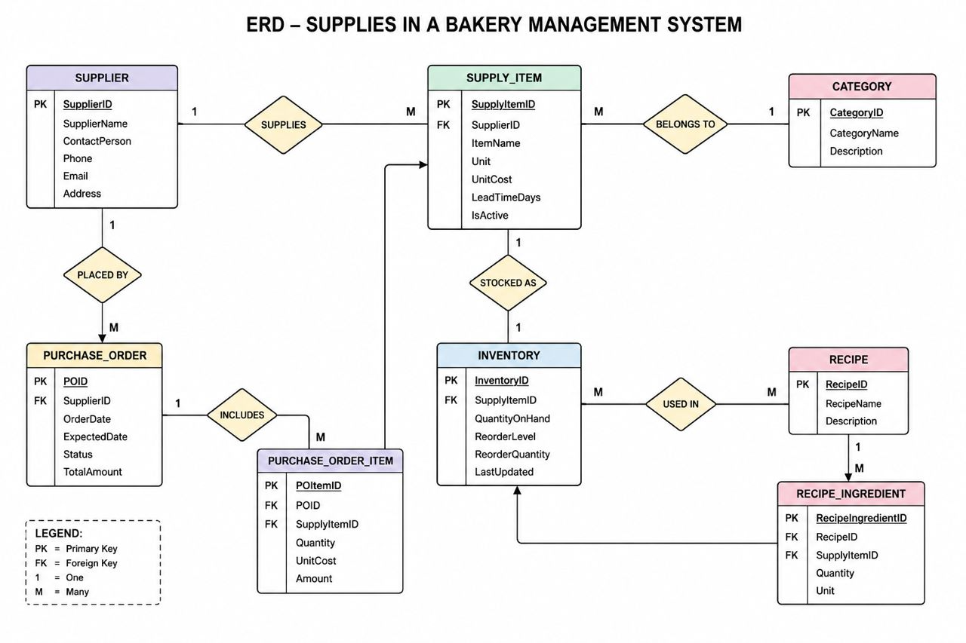

Slide 19
Etity relationships
One Supplier supplies many Supply Items.
One nSupplier can have many Purchase Orders.
One Purchase Order can result in one or more Deliveries.
One Staff member can receive many Deliveries.
One Customer can place many Sales Orders.
One Product can appear in many Sales Orders.

Slide 20
SUMMARY OF RELATIONSHIP TABLE
Entity 1 | Relationship | Entity 2 | Cardinality
supplier | supplies | Supply item | One to many
supplier | places | Purchase order | One to many
Purchase order | Results in | Delivery | One to many
Staff | receives | Delivery | One to many
customer | places | Sales order | One to many
Product | Appears in | Sales order | One to many

Slide 21
supplies Database System Physical Design
Entity | Attributes9PK=Primary Key,FK=foreighn Key) | data Type | Constraints
Employees | ID(PK),Name,Role,Phone | INT,VAR,VAR | NOT NULL
Supplies | ID(PK),Item Name,Category,Price | INT,VAR,DEC | UNIQUE
Inventory | InvID(PK0,SupID(FK0,Stock,MinLevel | INT,INT,DEC | 1:1 Link
Orders | OrdID(PK),EmpID(FK),Date,Total | INT,INT,,DTE | AUTO-TIMESTAMPAA
Items | DateID(PK),OrdID(FK),SupID9FK0,ty | INT,INT,DEC | Junction Tables

